Slide 1
Feature Engineering (FE) & Exploratory Data Analysis (EDA) Healthcare Fraud Detection
Varadharajan Suresh vs2769

Slide 2
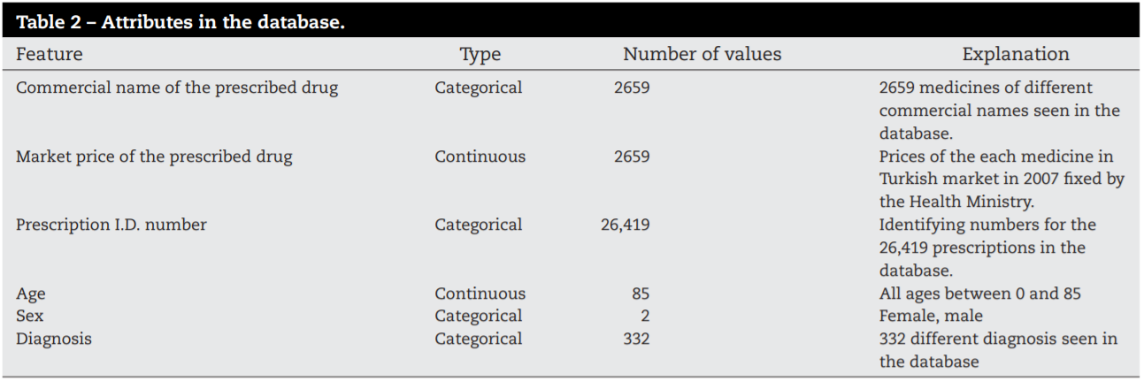
Paper Summary - A prescription fraud detection model
Huge amount of money spent in Healthcare System due to fraud.
Existing system is manual and sampling and extrapolation.
Related Works
Supervised Learning
Unsupervised Learning
Hybrid Learning
Supervised Hybrid
Unsupervised Hybrid

Slide 3
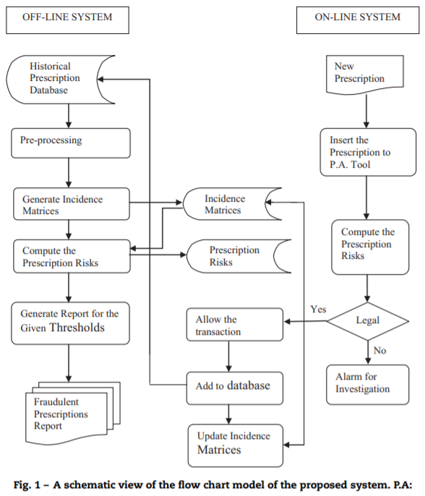
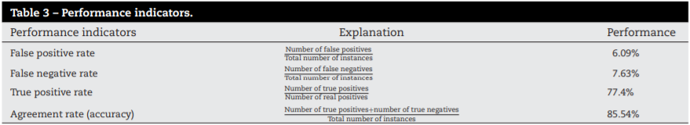
Paper Summary - A prescription fraud detection model
Proposed Approach: Nonlinear, black-box supervised algorithms
Methodology
Off-Line Processing
Medicine and age domain incidence matrix: MA.
Medicine and sex domain incidence matrix: MS.
Medicine and diagnosis domain incidence matrix: MD.
Medicine and medicine domain incidence matrix: MM.
Diagnosis and cost domain incidence matrix: DC.
Online Processing
Risk Assessment
Conclusion

Slide 4
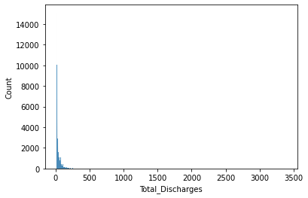
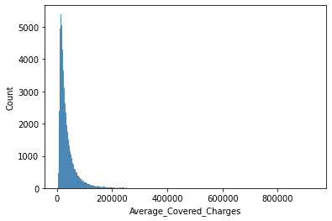
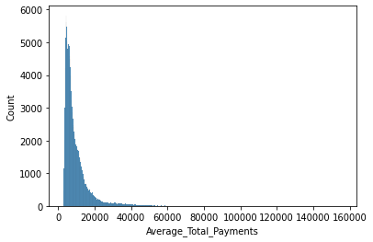
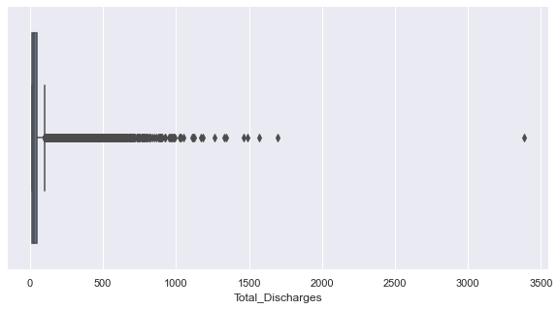
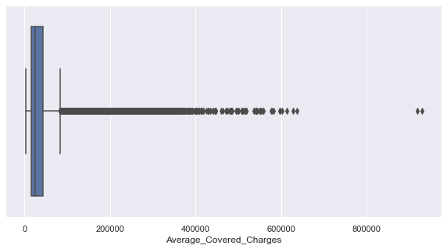
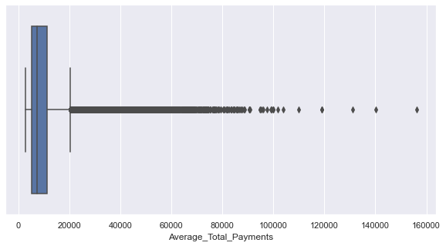
EDA &FE - Healthcare Fraud Detection

Slide 5
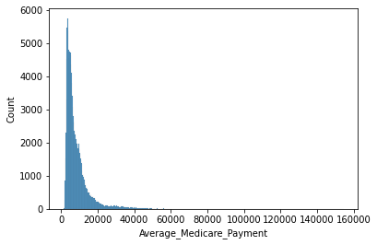
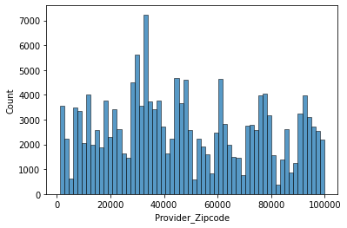

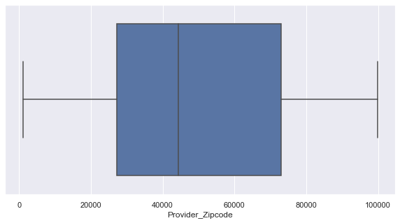
EDA &FE - Healthcare Fraud Detection

Slide 6
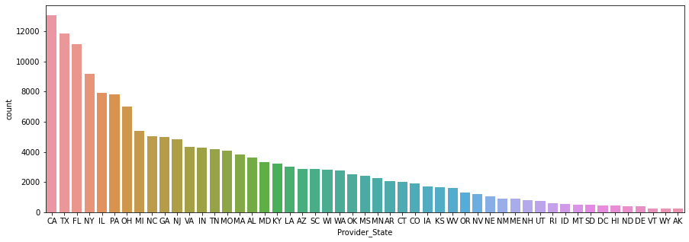
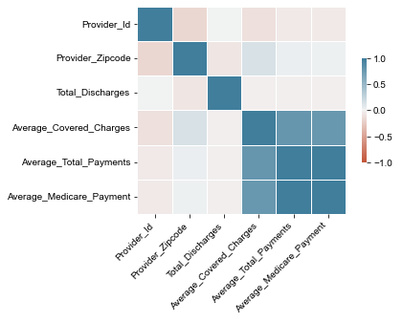
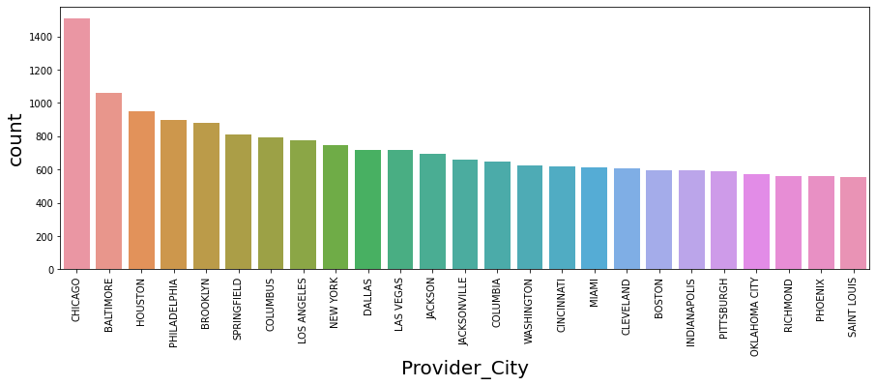
EDA &FE - Healthcare Fraud Detection

Slide 7
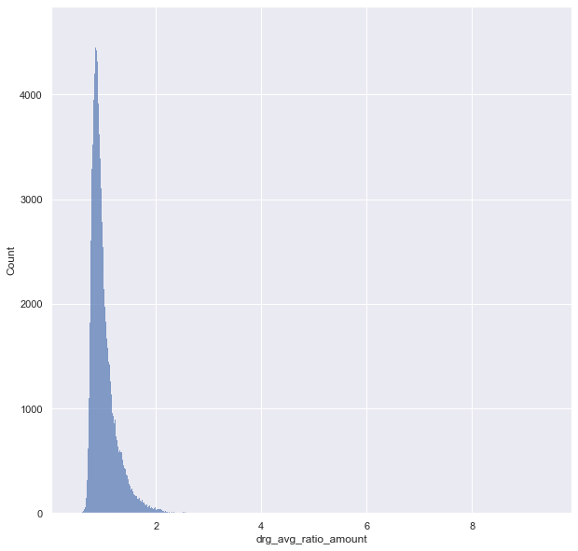
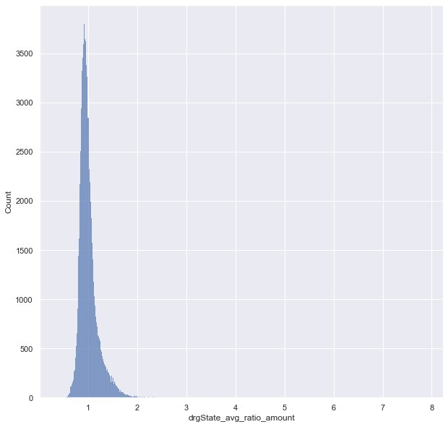
EDA &FE - Healthcare Fraud Detection
Most of the cities, over 75% have similar charges a specific DRG but there stands an outlier costing 9 times the average. 195 hospitals cost double over other and 2 stand out extremely ST JOSEPH MEDICAL CENTER, PA costs 8 times more and STURDY MEMORIAL HOSPITAL, MA 9 times more.
Most hospitals cost, over 75% have similar charges in a given state for particular ailment. over 124 cost over double their states average and again ST JOSEPH MEDICAL CENTER, PA and STURDY MEMORIAL HOSPITAL, MA stand out as extremes.

Slide 8
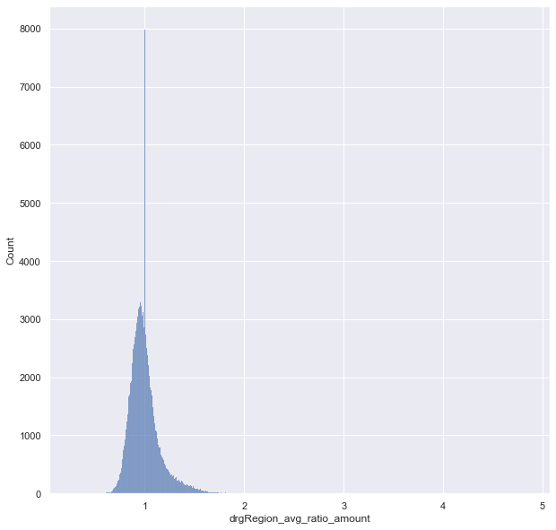
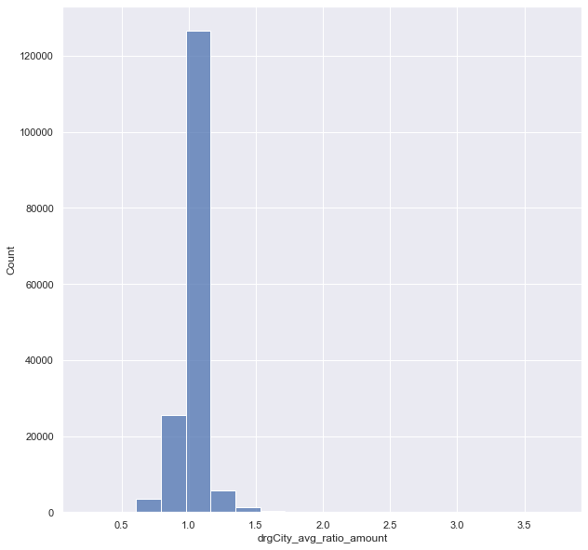
EDA &FE - Healthcare Fraud Detection
Most charges within a given hospital referral zone charges are constant, 64 charge double and 2 stand as extreme outliers THE JOHNS HOPKINS HOSPITAL,MD and CANCER TREATMENT CENTERS OF AMERICA, PA charging quadruple times the cost.
Most hospitals cost similar charges in a given city for particular DRG. over 14 of them cost over double their city's average and again THE JOHNS HOPKINS HOSPITAL,MD and CANCER TREATMENT CENTERS OF AMERICA, PA stand out as extremes charging triple the cost.

Slide 9
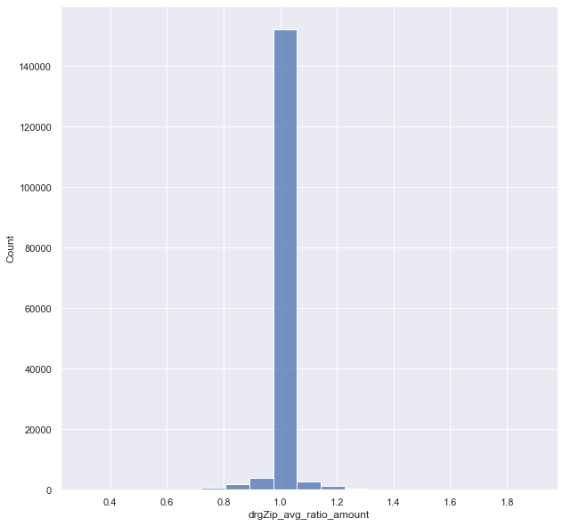
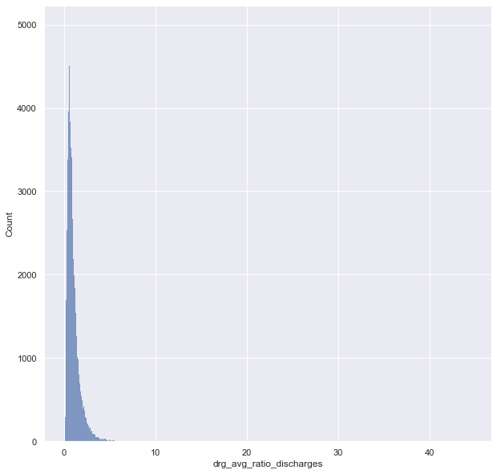
EDA &FE - Healthcare Fraud Detection
Most of the hospitals, over 75% have similar discharges a specific DRG but there stands an outlier attending 44 times the average. 1,259 hospitals have double discharges over others in their cities and ADCARE HOSPITAL OF WORCESTER INC stand out 44.5 times discharges for alcoholism related treatments.
All hospitals in a given charge same price, just 8 hospitals charge 50% more that other hospital

Slide 10
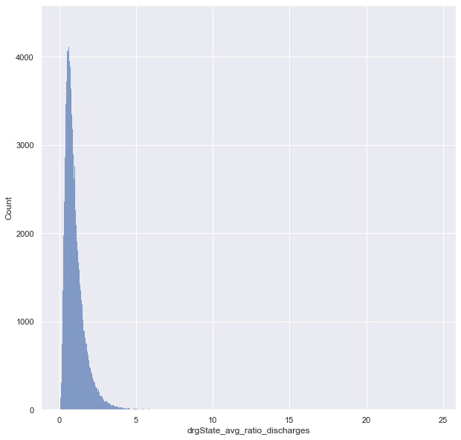
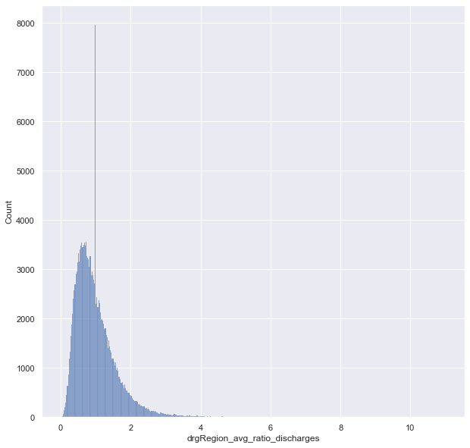
EDA &FE - Healthcare Fraud Detection
Most hospitals have similar discharges rates over 75% in a given state for particular ailment. over 1,227 have over twice their states average and HOSPITAL FOR SPECIAL SURGERY, NY stands out in joint replacement and reattachments.
Most discharges within a given hospital referral zone charges are constant, 1,227 have double discharge rate and 4 stand as extreme outliers having 11times more discharge rates, HOSPITAL FOR SPECIAL SURGERY, NY and ADCARE HOSPITAL OF WORCESTER INC, MA are to be of special mention of the 4.

Slide 11
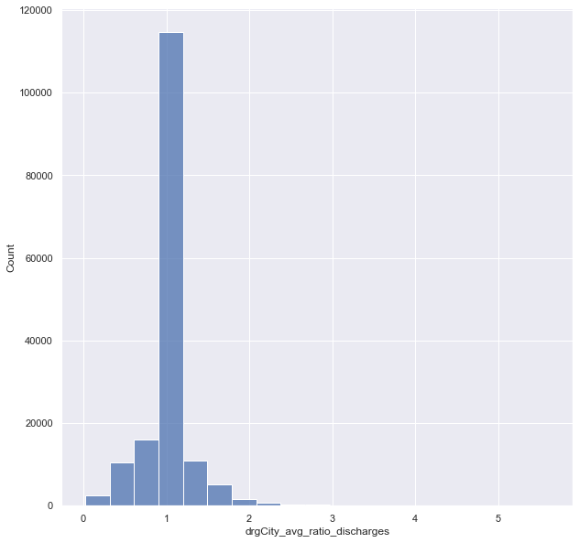
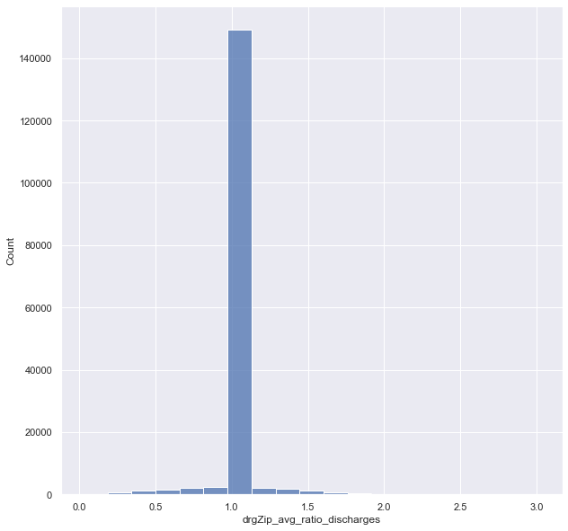
EDA &FE - Healthcare Fraud Detection
Most hospitals cost similar charges in a given city for particular DRG. over 285 of them cost over double their city's average. 5 hospitals charges 5 times their cities averages and HOSPITAL FOR SPECIAL SURGERY, NY appears again as an outlier.
All hospitals in a given Zip code have similar discharge rates,12 have twice the discharges in a given zip. PLAZA MEDICAL CENTER OF FORT WORTH FW, TX has trice the discharge rate for major joint replacement and reattachments

Slide 12

Thank You

